Slide 2
Aim
I can explain what mindfulness is.
Success Criteria
I can recognise when my mind wanders.
I can label my thoughts.

Slide 3

The Big Questions

Slide 4
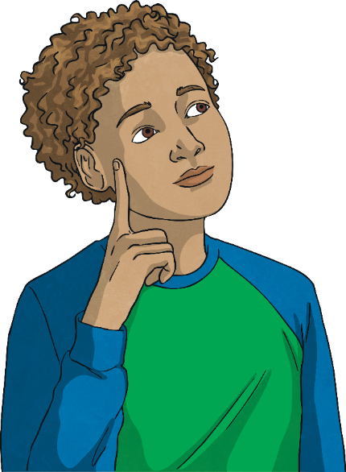
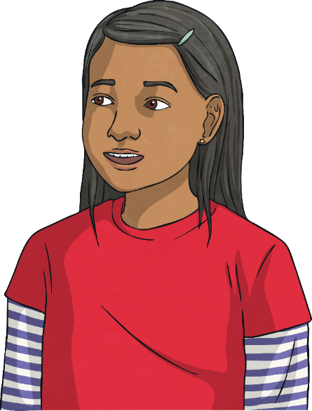
The Big Questions
What is Mindfulness?
Is it easy or difficult to pay attention?
What happens when we do not pay attention?
Talk about these questions with someone in your family.
What a lot of interesting ideas!
Now let’s explore these a little more.

Slide 5
Reconnecting

Slide 6

Stressed, Sad,
Anxious or Angry:
Mindfulness and Mental Health
Today we are going to be exploring a new subject.
This subject is called Mindfulness. We are going to use mindfulness to help us understand how we are feeling and how we can help ourselves be more settled and calm.
Understanding how we are feeling and how this can affect our behaviour is very important. It can help us feel more calm and settled.
It can also help us manage and live with our more difficult emotions such as:
feeling stressed,
feeling anxious,
feeling sad,
feeling angry.
There are no ‘good’ or ‘bad’ feelings!

Slide 7
Stressed, Sad,
Anxious or Angry:
Mindfulness and Mental Health
Feeling this way from time to time is perfectly OK. There is nothing to be afraid of or ashamed of in feeling stressed, anxious, sad or angry.
These feelings are often labelled as ‘bad’ but there is no such thing as a bad feeling or emotion. Worries we have tend to come from our reaction to the emotion or feeling.
Everyone experiences these emotions – friends, family, parents and even teachers!

Slide 8
Stressed, Sad,
Anxious or Angry:
Mindfulness and Mental Health
If we do not understand these emotions and how they can affect us, they can affect our mood and our mental health.
Sometimes, our more challenging emotions can take over our life and we can find ourselves feeling very sad and unhappy.
Mindfulness teaches us to be aware of, and understand our emotions. By practicing mindfulness when we experience challenging emotions, it can help us to let them go.
This helps us to be more happy and content.
There are no ‘good’ or ‘bad’ feelings!

Slide 9
Exploring

Slide 10
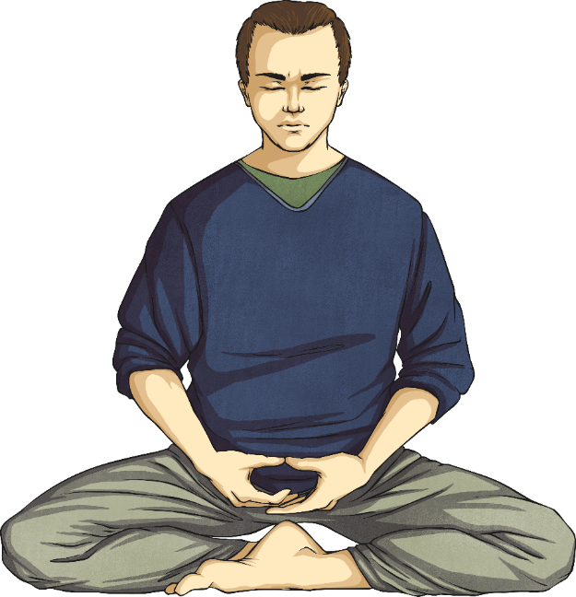
What is Mindfulness?
Mindfulness is a practice and discipline that allows us to explore our experience.
Mindfulness is a form of training where we train ourselves to be focused, settled and calm.
We learn to focus on our thoughts, feelings and physical feelings and see how they shape or affect our mood and behaviour.
In mindfulness we are learning to pay attention and to notice when our mind has wandered off into thinking and day dreaming.
Psychologists have found that we spend nearly half of our day not focused but daydreaming!

Slide 11
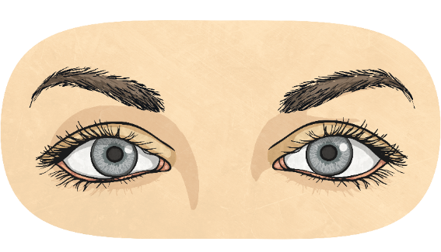

The Scattered Mind
Our minds can be full of thoughts.
It is OK to be scattered but it can make it very difficult to concentrate on one thing.
Now open your eyes. What happened to your concentration?
Just for a moment, close your eyes and imagine yourself enjoying your favourite activity.
This lack of focus is often described as The Scattered Mind in mindfulness.
If you feel happy to, share your thoughts with the class.
Allow the memories of doing this activity to appear. Now try and keep focusing on this activity as I ask you to think about different things:
You have homework to do.
You need to tidy your bedroom.
Your brother, sister or friend is doing something that annoys you.

Slide 12
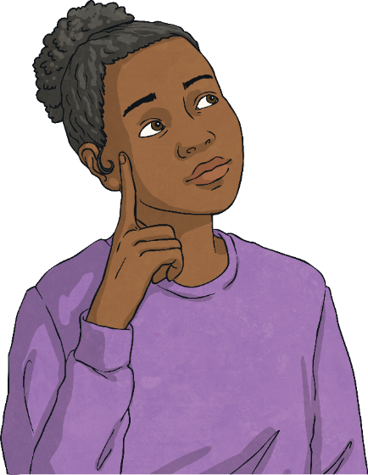
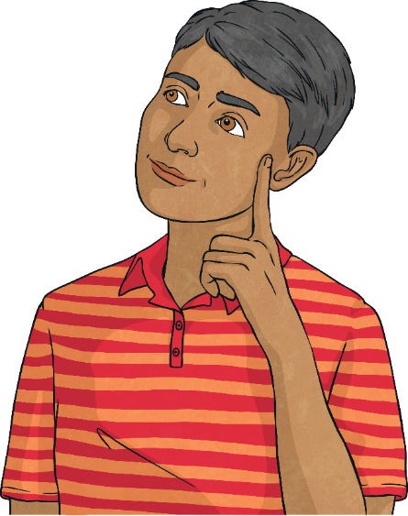
The Scattered Mind
Having a scattered mind is OK. Our minds will wander, we will get distracted.
However, a scattered mind affects more than our concentration.
It can also affect how we are feeling.
The psychologists who discovered that we spend nearly half of our days daydreaming, found that when our minds are scattered, we are more likely to feel stressed, anxious, sad or angry.
This is because instead of experiencing our life as it is, we get caught up in thinking, worrying and being anxious about how things were or how they could be.

Slide 13
The Scattered Mind
Over time this can affect our mood, our behaviour and our mental health.
Learning to settle the scattered mind is a key part of learning to be calmer and happier.
Through mindful meditation practices, we can train our mind to be more calm.
We can try this now with the Breath and Thoughts Meditation.

Slide 14
Guided Practice

Slide 15
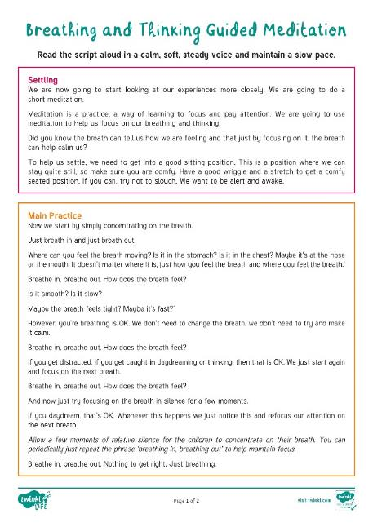
Breathing and Thinking
Consolidating
Reflecting

Slide 16
Consolidating

Slide 17


Thought Clouds
Practicing mindfulness can be difficult. Sometimes, no matter how hard we try to settle the mind, we keep getting caught up in our thoughts.
Instead of just noticing that we are thinking, our mind takes over and before we know it, we are stuck in a whirlwind of thoughts about all kinds of things.
Thoughts become more thoughts and they become more thoughts! Soon we can feel like all we have are thoughts!
To help us be more mindful, we can use the Thought Clouds to help us recognise and let go of thoughts.
This is a very important part of being mindful. We are not ignoring our thoughts, but we are not being carried away by them either.

Slide 18
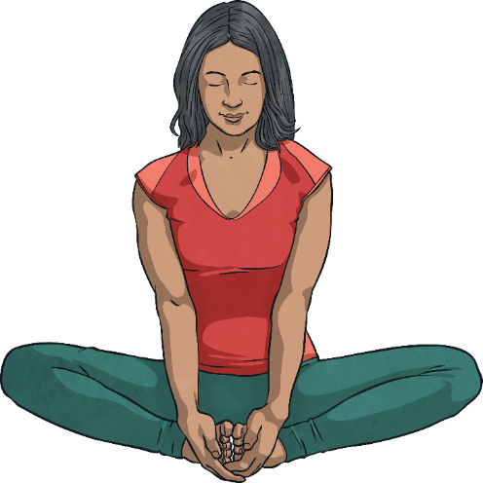
Thought Clouds
Just stop for a few moments. Set aside five minutes to stop and sit, stand or lay still. Close your eyes if this helps.
Now, just focus on your breathing. Feel the sensations of breathing.
Each time you notice a thought, say to yourself (either out loud or silently in your head) ‘I am thinking’, open your eyes and then write the thought on one of the clouds.
Look at the thought for a few moments and then, ‘let it go’ (you can even gently move the card away from you or drop it).
Go back to focusing on breathing.

Slide 19
Thought Clouds
Each time you notice a thought, say to yourself (either out loud or silently in your head) ‘I am thinking’, open your eyes and then write the thought on one of the clouds.
Look at the thought for a few moments and then, ‘let it go’ (you can even gently move the card away from you or drop it).
Keep doing this for a few minutes before opening your eyes and getting back to your day.

Slide 20
Reflecting

Slide 21
Sharing our Experiences
Now let’s share our experiences of the activities we have done today.
Take a moment to think about your answers to these questions.
What did you notice?
Did the mind wander?
What happened to your thoughts when you labelled them?
Now if you feel happy to, please share your answers to each question with the class.

Slide 22
The Big Questions

Slide 23
The Big Questions
What is Mindfulness?
Is it easy or difficult to pay attention?
What happens when we do not pay attention?
Talk about these questions with a partner.
What is the most useful thing you have learnt today?

Slide 24
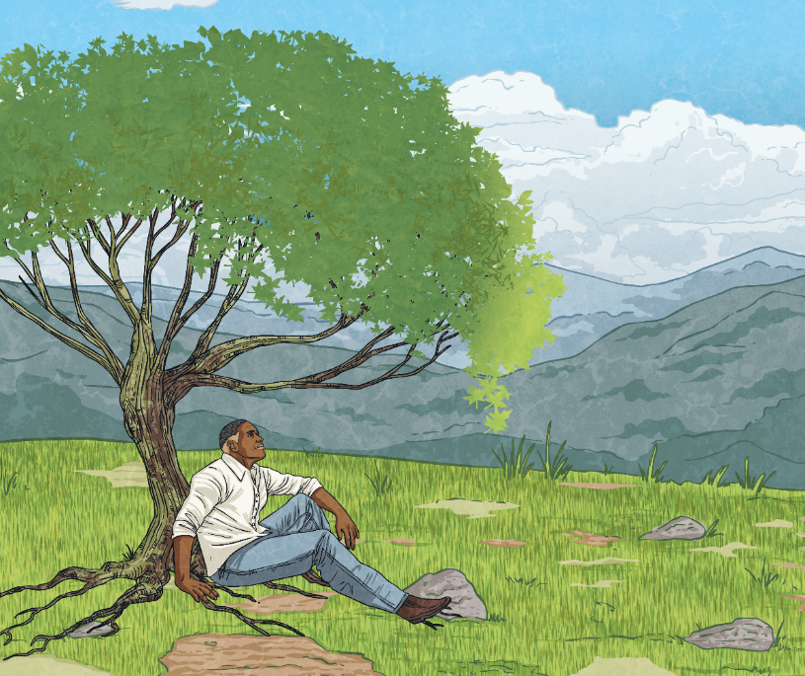
Mindfulness Helps to
Settle the mind.
The mind is naturally scattered.
Learning to focus the mind can help us to settle and feel calm.
This can help us to better understand our feelings and emotions.
It can help us to not get so distracted by our thoughts.
Practicing mindfulness can have a positive impact on how we feel and on our mental health.

