Slide 1

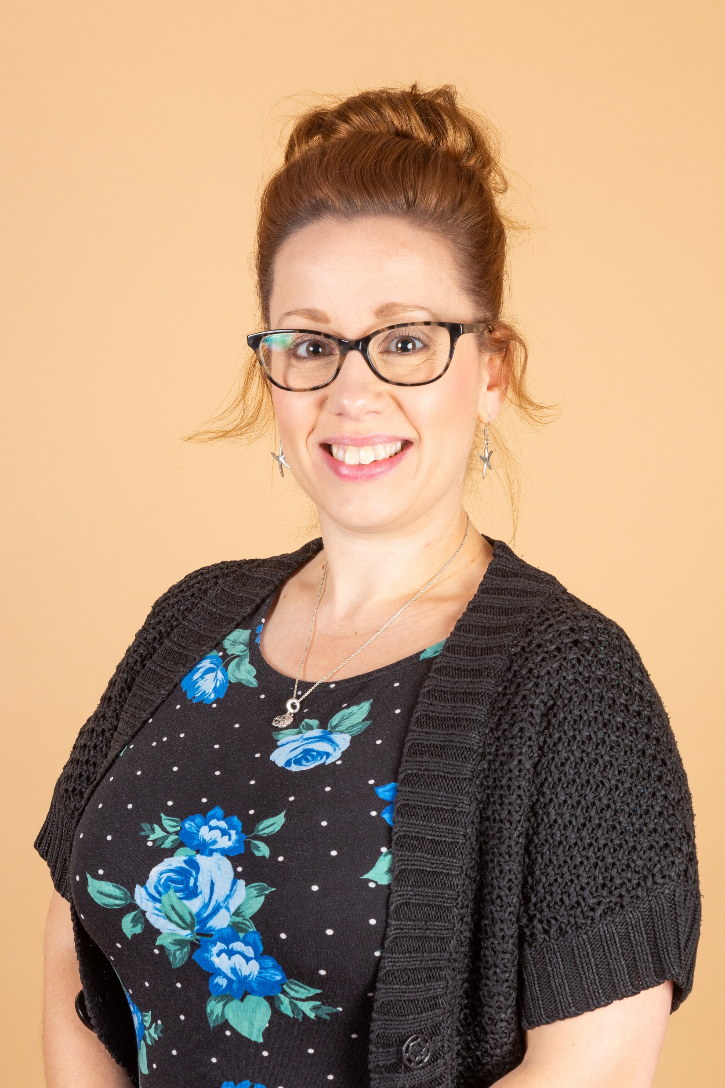
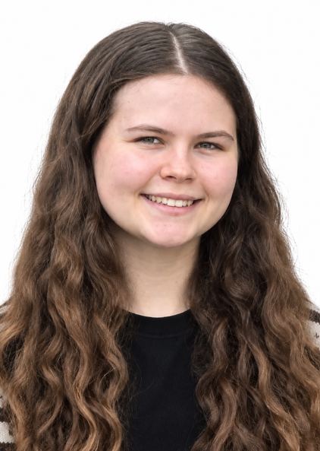
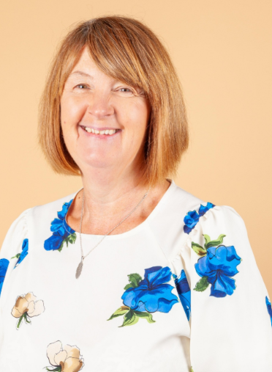
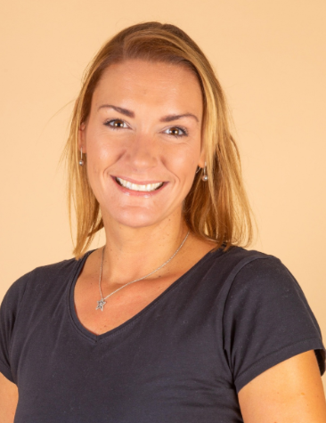
Welcome to Year 4!
Meet our team…
Mrs Savage
Year 4 Class Teacher
History Subject Leader
Voice 21 lead
Early Career Teacher Mentor
Miss Marriott
Year 4 Class Teacher
Mrs Waby
Year 4 Teaching assistant
Mrs Allen
Year 4 Teaching assistant
You are welcome to ask any questions or share any information with us at the end of the school day, in person, or via the year group email address as follows: Y4@abbey.notts.sch.uk
Notes:
Both

Slide 2

Working Together
For teachers, your knowledge of your child, as well as your support through both positive and challenging times within your child’s primary school life, is crucial.
With your support we can:
Share the same high expectations at home and at school;
Upkeep effective communication between home and school;
Celebrate your child’s successes and progress;
Address any concerns/issues quickly and effectively;
Make sure that your child enjoys and excels during their time at Abbey Primary School.
Notes:
SLT

Slide 3
Behaviour Expectations and School Rules
Our expectations for behaviour are consistently high so that our school remains a happy place where children learn and thrive in a positive environment. Positive behaviour is generously rewarded with personalised praise, house points, star awards certificates and ‘Values Awards’.
At Abbey, children learn how to be kind, considerate and empathetic young people who understand how to make positive choices in all aspects of their lives.
Our School Rules
We only have 5 school rules so that they are easy to remember. These are displayed around school and in every classroom.
On occasions where behaviour incidents occur, it is made clear to the child which rule they have broken.
Stage1: In the event of a child behaving in a way that goes against one of the school rules, the child is given a reminder – at this point, it is deemed a mistake. This usually works to get things back on track and no further action is necessary.
Stage 2: If the child does not rectify this behaviour, then a verbal warning will be given.
Stage 3: If the child continues to break one of our school rules following a verbal warning, they will receive a yellow card. At this point, the child will have a restorative conversation with a member of staff, missing a short period of their playtime.
Stage 4: If a fourth incident occurs, the child will be receive a red card. This will result in the child meeting with a member of the Senior Leadership Team to have a restorative conversation during their lunchtime. If a child receives a red card, parents/carers will be informed.
Always try your best
Show respect
Take care of one another and our things
Move calmly and silently around school
Dress to Impress
Notes:
SLT

Slide 4
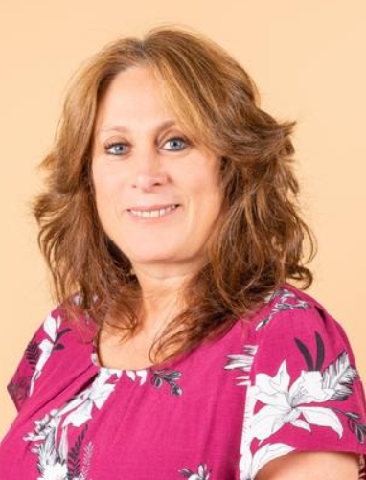
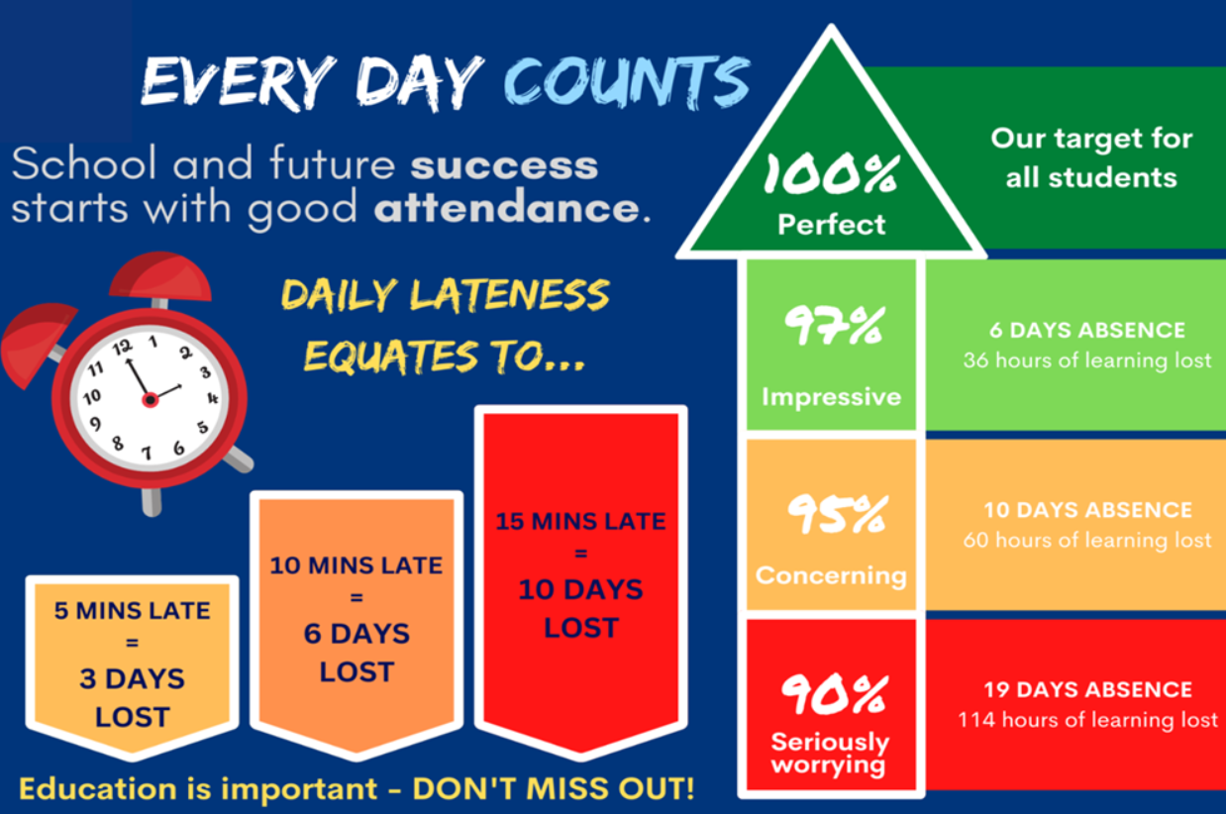
Attendance and Punctuality
We expect all our children to attend school regularly and on time to enable them to take full advantage of the educational opportunities available. Regular, punctual attendance is positively encouraged and supported for every child.
School reserves the right to fine families who choose to take holidays during school time. This right will be actioned to ensure that pupils receive the best possible educational provision.
The school rigorously supports and monitors attendance. The expected pupil attendance target is at least 97%.
Always phone or email the school office with a reason for your child’s absence.
Any unexplained absences will be followed up with a telephone call or home visit from the school’s attendance officer, Mrs Warren.
Ensure that all holidays are booked during the school holidays.
Mrs Warren
Attendance Officer
Family Support Worker
Notes:
KM

Slide 5

Child Illness and Administration of Medication
If a child appears unwell at school, staff will assess and monitor their presentation. If they are then deemed to be too unwell to remain in school by Mr Harris or Mrs Wolfe, parents/carers will be contacted and informed by a member of the school office team.
After consultation with the school office, any short-term/long-term prescribed medicine should be labelled with child’s name, dosage and timings. A short-term or long-term medical form will need to be signed and completed by the parent.
Medications will be stored and administered appropriately by the school office.
Children are not allowed to have medicine in their bookbags or on their person (this includes cough sweets/lozenges or creams).
Some types of medicine cannot be administered in school and in such cases, parents/carers will need to come into school to do this. Speak to the school office to check at the time of the prescription.
If your child suffers an injury in school, a member of staff will record the details of this on Medical Tracker and you will receive email notification. In cases where they have bumped their head, you will also receive a phone call.
Notes:
HS

Slide 6
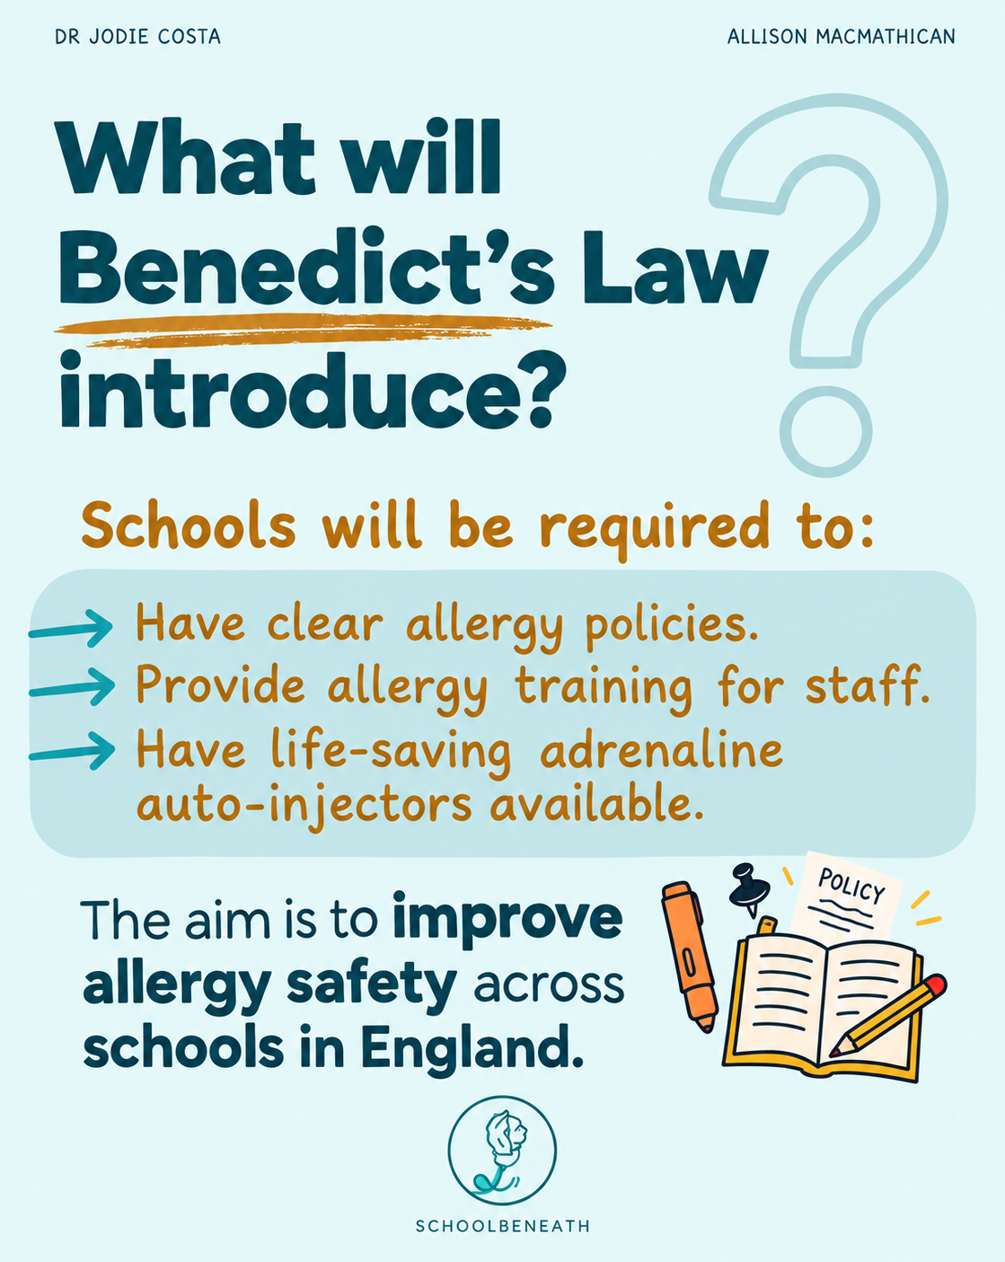
Please ensure that your child's medical information is kept up to date. You can do this on the Arbor app.
Inform school immediately of any new information related to allergies and complete a long term medical form.
Depending on the severity of your child's allergy, an action and healthcare plan may be required.
Ensure medication is in school and dates are regularly checked.
Notes:
KM

Slide 7
School Uniform
Wearing the Abbey school uniform plays a key role in promoting children’s pride, self-confidence, and their feeling of belonging within our school community.
This should consist of:
A burgundy sweatshirt or cardigan either plain or embroidered with the school logo
A grey skirt or pinafore dress or grey trousers
A red gingham dress or grey or formal shorts (summer uniform for warmer weather)
White shirt or white / burgundy polo shirt (plain or embroidered with the school logo)
Sensible, black, flat shoes (no trainers - unless it is a PE day)
Jewellery: In the interests of health and safety, the only jewellery that children are allowed to wear in school are wristwatches (no smart watches) and plain, stud earrings.
All uniform with the school logo can be purchased from our supplier ‘The Schoolwear Centre’ in Mansfield (also available online).
Notes:
HS

Slide 8
PE Kit and Information
On PE days, children should come to school dressed in their PE kit (including trainers).
This consists of:
A white or burgundy t-shirt - plain or embroidered with the school logo (available from the Schoolwear Centre)
Plain black shorts
Suitable trainers
For outdoor PE sessions and in the winter months, children can wear plain black tracksuit / leggings and fleece/sweatshirt.
All jewellery must be removed before participating in any PE or sporting activity (including earrings – tape is not allowed for health and safety reasons) and long hair must be securely tied back.
In Year 4 this term, the PE days are: Monday (outdoor) and Tuesday (indoor or swimming)
Notes:
KM

Slide 9
The following are not allowed:
At Abbey, we want our children’s focus and pride to be on their learning. Dressing to impress helps this to happen and therefore we ask that the items below are avoided:
Rucksacks or Large Bags: Pupils must only bring Abbey Primary School bookbags to school. Children’s coat pegs are in the classrooms and therefore space for bulkier bags isn’t available and can pose a hazard. Bookbags also help to keep our school reading books in the best possible condition.
An additional bag can be brought in when pupils need to change after school e.g. sports’ clubs or events.
Coloured or Extended Hair: Wherever possible, long hair should be tied back. Children’s hair should be naturally coloured and hair extensions should not be worn during term time. Alice-style headbands should be sensible and neat – animal ears and unicorn horns should be saved for non-uniform or themed days!
Make Up, Nail Varnish or False Nails: Cosmetic additions such as make-up, hair extensions, dyed hair and nail varnish can all pose a health and safety risk, including allergies or injuries to others, and must not be worn in school.
Notes:
HS

Slide 10

Abbey’s School Values
Abbey Primary School holds 6 school values:
RESPECT, RESPONSIBILITY, RESILIENCE, INTEGRITY, INCLUSION and ASPIRATION.
We focus on a new value each half term, starting with RESPECT in the first half of the autumn term – it will further strengthen your child’s understanding of these values if you recognise and celebrate the times when they display them at home, just as we do at school.
As children display the school values in their conduct, in their work and in their interactions with each other, they will earn house points.
Notes:
KM

Slide 11

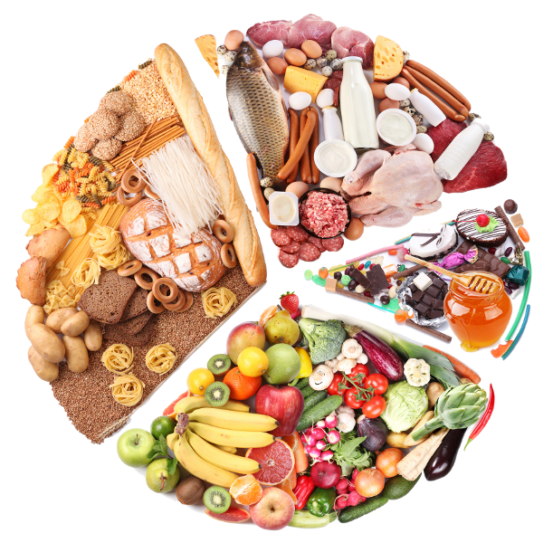
Lunch and Snacks
Year 4 lunchtime takes place between 12:00 and 1:00pm.
School Meals or Packed Lunch
We are a Healthy Eating School and aim to promote healthy diet and lifestyle choices for children. With this in mind, we ask you to provide lunchboxes that contain a balanced meal, with minimal sweet treats – and alternatives wherever possible. Fizzy or energy drinks must not be brought to school or taken on school visits.
On school visits or trips, children who usually enjoy school dinners can request a packed lunch to be provided by the school, but this must be booked in advance.
Breaktime Snacks
Children can bring a healthy snack to have during break time
In KS2, a snack can be purchased from school at an additional cost
Children can also opt to have a drink of milk during morning playtimes, this can be purchased through the Cool Milk website https://coolmilk.com/schools/
Water Bottles
A plastic bottle can be brought to school filled with water, this can be refilled during the day as necessary and will be available for your child throughout the day. No fizzy, sugary or energy drinks are allowed.
Notes:
HS

Slide 12
Daily Routines
Children are expected to enter and exit the school site calmly and sensibly. Scooters and bicycles must not be ridden on the school premises and children should dismount at the entrance to the school drive. The castle and trim trail must not be played on before or after school.
8:25am | School Gates Open
8:35am-8:45am | Children enter school through the KS2 door
8:45am | Registration
8:45-9:00am | Time to solve
9:00am – 9:45am | Reading
9:45am-10:30am | Maths
10:30am – 10:45am | Breaktime
10:45am-11:45am | Handwriting and English
11:45am – 12:00pm | Storytime
12.00pm – 1:00pm | Lunchtime
1:00pm-1:15pm | Spelling
1:15pm- 2:45pm | Foundation subject
2:45-3:10pm | Assembly
3:15pm | End of the School day
If someone different is collecting your child, please let the class teacher know – either directly or via the school office prior to the event.
Notes:
KM

Slide 13
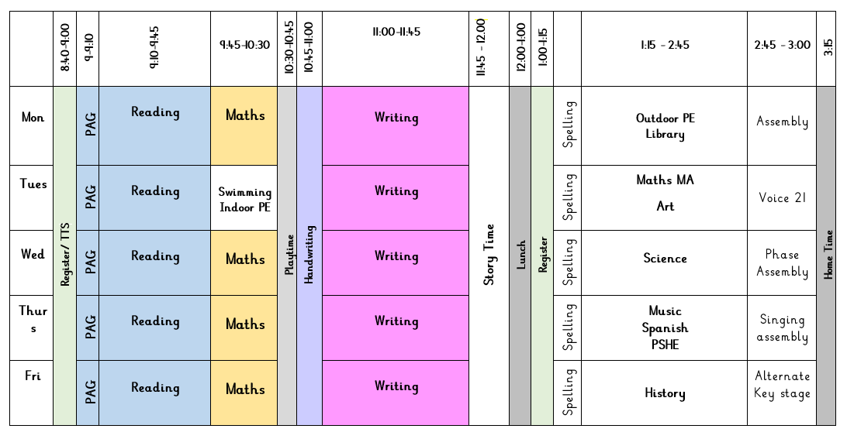
Year 4 Weekly Timetable
Example weekly timetable for Year 4:
Notes:
HS

Slide 14
Reading for Progress and Pleasure
In Year 4, reading is taught in daily lessons that prioritise pupils’ enjoyment, fluency and comprehension of a wide range of texts. It is crucial that children learn to read at an effective pace, and with the required accuracy and expression to be able to understand the content of the fiction, non- fiction and poems that they encounter. Explicit teaching of new vocabulary takes place at the beginning of each lesson to support pupils’ understanding of what they read and the subsequent discussions that take place.
For some children, reading is taught in daily phonics lessons that improve children’s fluency and understanding. At Abbey, we follow the Read, Write, Inc. phonics scheme. Children read daily in their phonics group, also practising spellings linked to their phonics learning. Children are assessed half termly to ensure they are making progress and are in the appropriate phonics group.
Reading Practice
Reading with your child, and to your child, will be hugely beneficial to their fluency and comprehension, subject knowledge, vocabulary and writing. For this reason, we ask for you to support our work in school by reading with your child at least 5 times a week and completing a record of this on the ‘Learning with Parents’ website. Children will change their reading books weekly.
Reading for Pleasure
Each classroom is equipped with treasure chest box full of specially chosen fiction, non-fiction texts and poetry books that children can treat as their own, to enjoy at home and at school .
Daily story time happens after lunchtime each day so that children continue to hear stories read by a good role model and receive the benefits that this brings, academically, socially and emotionally. Children are introduced to new authors during ‘First Chapter Fridays’ and a range of poetry is promoted through a weekly ‘Rhyme Time’ focus.
‘Learning to read’ is crucial so that your child can ‘read to learn’ across the whole curriculum!
Notes:
KM

Slide 15
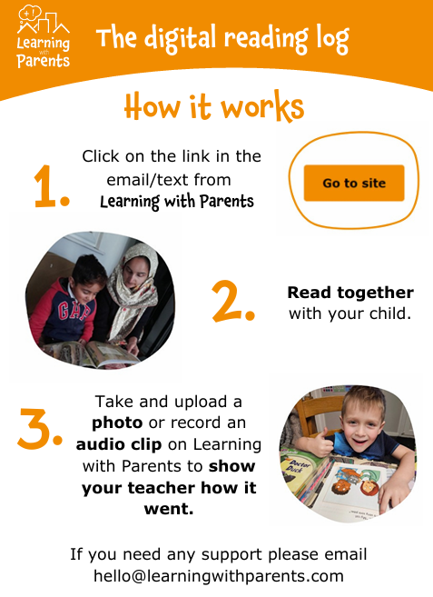
Learning with Parents
There is no expectation for your child to use the online platform. Use this time to enjoy reading with you child.
At a convenient time for yourself, click the link and log your reading.
There is no expectation to add a photo or audio clip but if you want to, amazing!
Notes:
KM

Slide 16
Year 4 Weekly Homework Expectations
​ Reading​ | ​ Spelling Task​ | ​ Maths ​ | ​ Times Tables Rock Stars​ ​
​ At least 5 reads per week are required including verbal discussion throughout to check understanding of the text.​ ​ | ​ 2 x spelling tasks assigned on the Oxford Owl website. | ​ A weekly maths task to consolidate the week’s learning and provide extra practice of the taught content.​ | ​ 5 x games of Times Tables Rock Stars to support the rapid recall of times tables facts.​
Notes:
HS

Slide 17
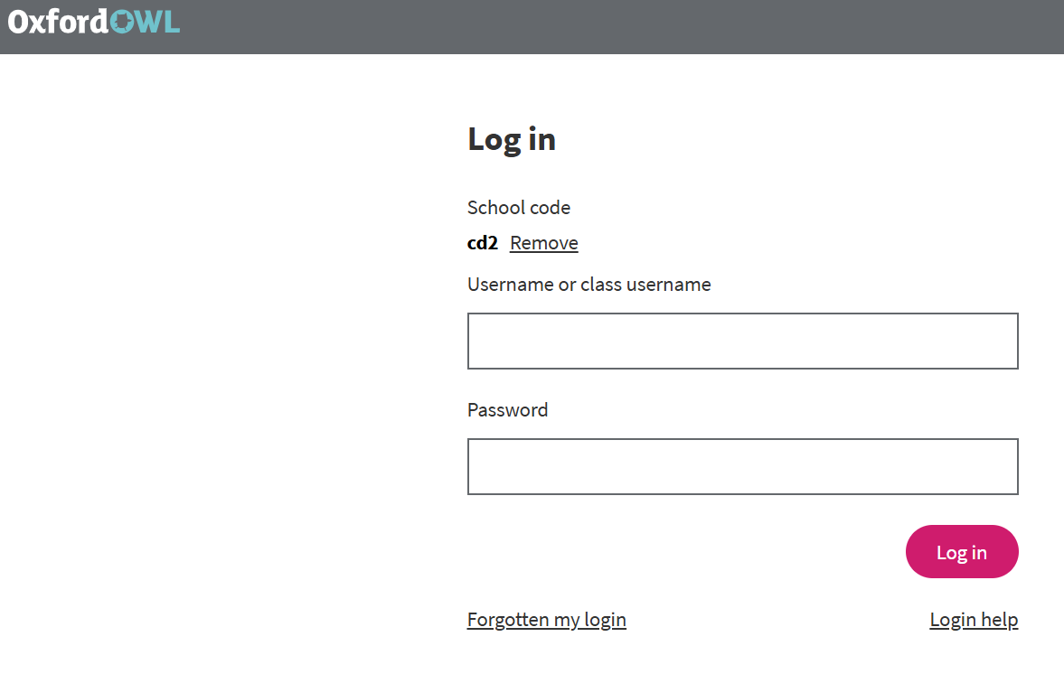

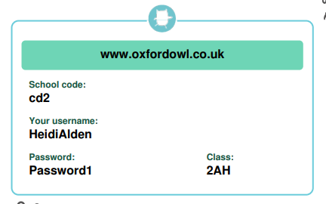
2 x activities a week
Overview of activities on the class page of the school website and in homework books with their log ins
Parent information booklet on the class page
Full name no spaces
Notes:
KM

Slide 18

Year 4 Multiplication Tables Check
Year 4 will sit the statutory Multiplication Tables Check during the second part of the summer term.
The check will happen on a day between 1st June and the 12th of June – date TBC.
The check is nothing to worry about for the children or for you and we will be doing lots of practice at school to prepare the children.
A few minutes practice, each evening at home, on ‘Times Tables Rock Stars’ will support them to feel as confident as possible, alongside the daily practice sessions that are happening in school.
If you are aware of a reason your child will not be in on any day during the timeframe above, please let us know so we can organise alternate dates.
25 questions from 0 x 12 to 12 x 12.
6 seconds per question
Notes:
HS

Slide 19

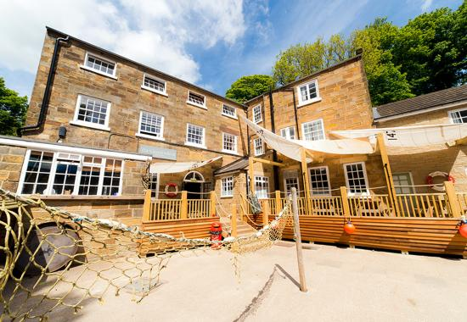
Residential Visit
In Year 4, pupils are given the opportunity to consolidate and apply their learning from across the curriculum during an action-packed two-night/three-day residential trip to Boggle Hole, Robin Hoods Bay!
Visits and Key Experiences
Mr Darlington’s Christmas in a Box
Christmas Pantomime
Mr Darlington creation workshop
Hindu Temple visit
Notes:
HS

Slide 20
Staying Informed
As well as in person with your child’s class teacher, there are many ways that you can stay in touch and up to date:
Letters: Letters containing details of any important information or upcoming visits or events are emailed to the necessary parents/carers in a timely manner.
Termly ‘Learning Journey’ Documents: Each term, you will receive your child’s ‘Learning Journey’ detailing the content knowledge and skills they will be learning across all areas of the curriculum. These will also include the current books that are being shared in school. As a result, you will be able to support your child by talking to them about what they are learning, choosing books to find out more or even going on related family days out.
Email: Y4@abbey.notts.sch.uk
You can contact your child’s class teacher via the year group email address. With consideration of their wellbeing, staff are not expected to respond to emails after 5:30pm but will aim to reply within 48 working hours of receipt.
School Website: Each class has a year group page on the school website under the ‘Children’ tab:
https://www.abbeyprimaryschool.co.uk/topic/children
This page is added to regularly with exciting news and photographs so that you can gain valuable insight into your child’s learning.
Weekly Newsletter: This is paperless and is emailed out every Friday and is also available on the school website. https://www.abbeyprimaryschool.co.uk/newsletters/
This contains information about events that have taken place in school, the children’s learning and all upcoming dates. It also includes information about attendance, staff changes and the weekly dinner menu.
Arbor App: Contact the school office if you need help to set this up on your phone. Linked to the school’s management information system, this is an excellent way to stay informed as well as to access a wealth of information, including your child’s current contact details, attendance, medical information etc.
Meetings: Occasionally, prior to important events such as residentials or when there are curriculum updates, you may be invited to attend meetings in school. Your attendance at such events is much appreciated and will also provide you with the opportunity to ask any questions.
Notes:
KM

Slide 21

Parents’ Evenings and Progress Updates
You will be invited to two parents’ evenings – one in October and one in February. During these, you will have the opportunity to discuss your child’s progress with their class teacher.
Each term, there will be a ‘Celebration of Learning’ where you will be invited to visit your child’s classroom at the end of the school day to spend time with them looking at their books and sharing in their success.
You will receive a written report at the end of the school year, sharing your child’s progress. This will be sent to you via email to save paper.
Pupils can also earn ‘Curriculum Awards’ for a range of subjects across the curriculum. These certificates are presented during assembly and will be brought home to share with you.
‘Star Award’ assemblies reward children for their personal, emotional and social contributions to school life. These certificates are presented during assembly and will be brought home to share with you.
If you have any concerns at any other point during the year, please contact your child’s teacher to discuss the issue as soon as possible so that we can provide support and overcome these at the earliest opportunity.
Notes:
HS

Slide 22

If you have any further questions, please contact us via the year group email address or catch us in person at the end of the school day.
The class teacher is your first point of contact in the first instance should any issues or concerns arise.
This Photo by Unknown Author is licensed under CC BY-NC-ND
Notes:
Both

