Slide 2
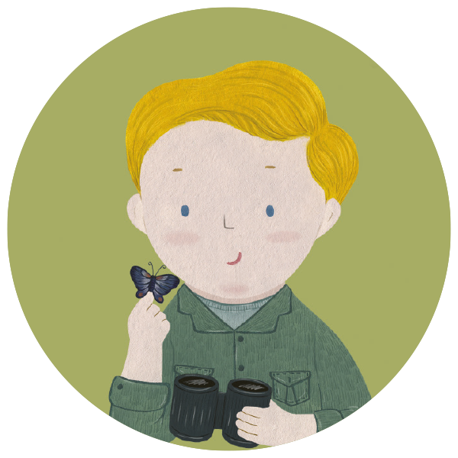
1. What year was David Attenborough born?
A
A
1916
B
B
1926
C
C
1936

Slide 3
2. What did David like to collect as a child?
A
A
feathers and shells
B
B
insects and birds’ eggs
C
C
birds’ eggs and fossils

Slide 4
3. Where did David go to study when he finished school?
A
A
Cambridge
B
B
Oxford
C
C
Manchester

Slide 5
4. What TV station did David work on
when he returned from the Royal Navy?
A
A
ITV
B
B
BBC
C
C
Channel 4

Slide 6
5. What was the name of the series David launched in 1954?
A
A
Zoo Adventure
B
B
Zoo Explorer
C
C
Zoo Quest

Slide 7
6. Why did David leave the BBC?
A
A
to study anthropology
B
B
to study maths
C
C
to study science

Slide 8
7. What kind of programs did David make when he returned to the BBC?
A
A
programs about space
B
B
programs about languages
C
C
programs about nature

Slide 9
8. What was David’s most successful series, with 96 episodes?
A
A
life on Mars
B
B
life on Earth
C
C
life on the moon

Slide 10
9. What do David’s most recent programs focus on?
A
A
The environment
B
B
The deserts
C
C
The oceans

Slide 11
10. What charity is David the UK ambassador for?
A
A
World Animal Charity
B
B
World Nature Fund
C
C
World Wildlife Fund

Slide 12
11. What was the focus of the COP26 conference?
A
A
oil
B
B
climate change
C
C
money

Slide 13
12. Which of the following is a job David has not had?
A
A
soldier
B
B
sailor
C
C
student

